Slide 1
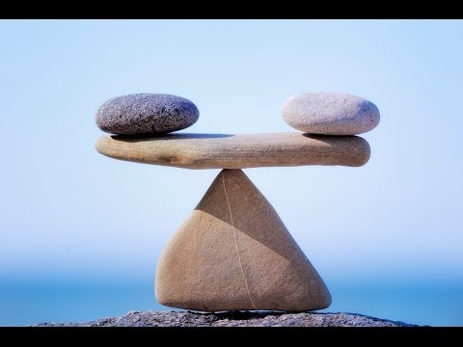
https://www.youtube.com/watch?v=5PIBMLvcAzc

Slide 2
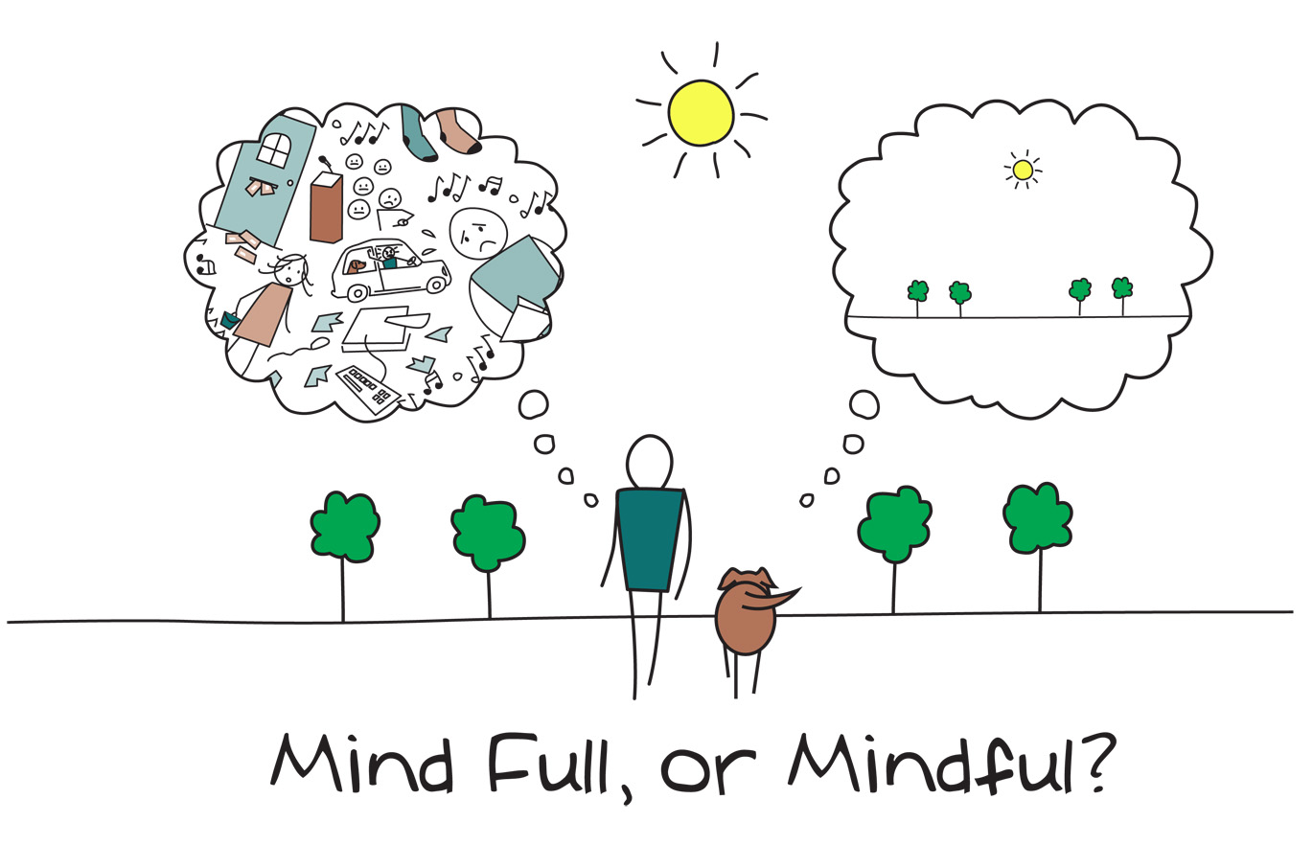
MISA London Symposium
“Creating Conditions for Excellence”
May 7, 2018
Notes:
Chime: this is a singing bowl that signals to our central nervous system (our amygdala) that we are safe, cared for and that we are about to engage in a conversation about mindfulness and wellness. Most of all it signals to our brains that our stories matter. Intros.

Slide 3
Well-being in Ontario Schools
Notes:
Show video Ministry’s Wellness strategy

Slide 4
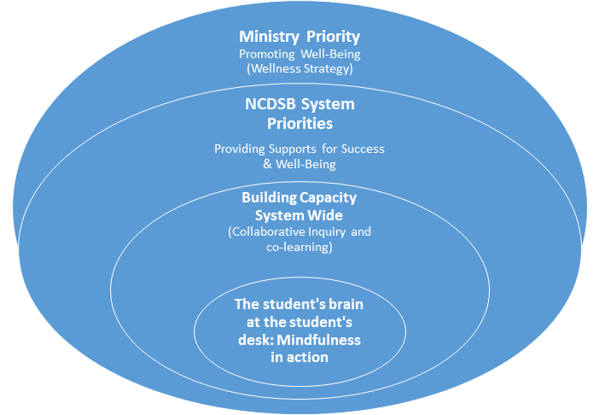
Just as ripples spread out when a single pebble is dropped into water, the actions of individuals can have far-reaching effects. Dali Lama
Notes:
Ah ha moment...started with Ministry but then it became the child

Slide 5
All our stories matter! Safe spaces for sharing!
Do not judge!
Accept!
Listen!
Be kind!
Be loving!
Be present!
Notes:
Paying attention to th th

Slide 6
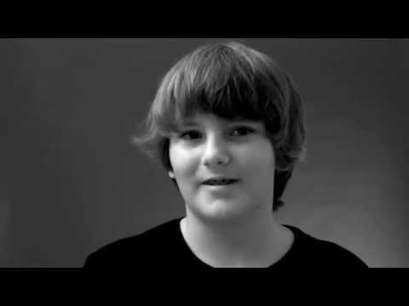
Notes:
Al

Slide 7
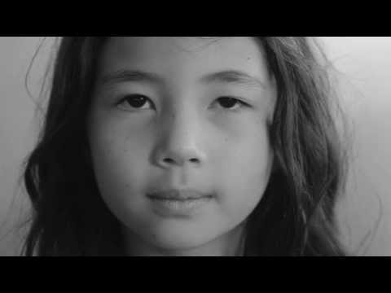
Mindfulness: Just Breathe

Slide 8
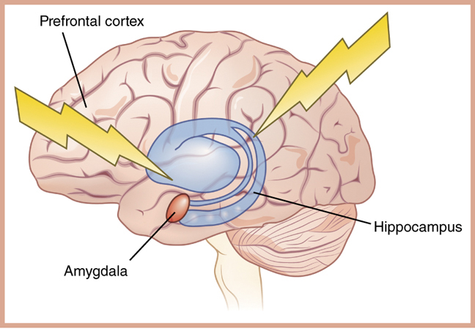
What’s happening in the child’s brain????

Slide 9
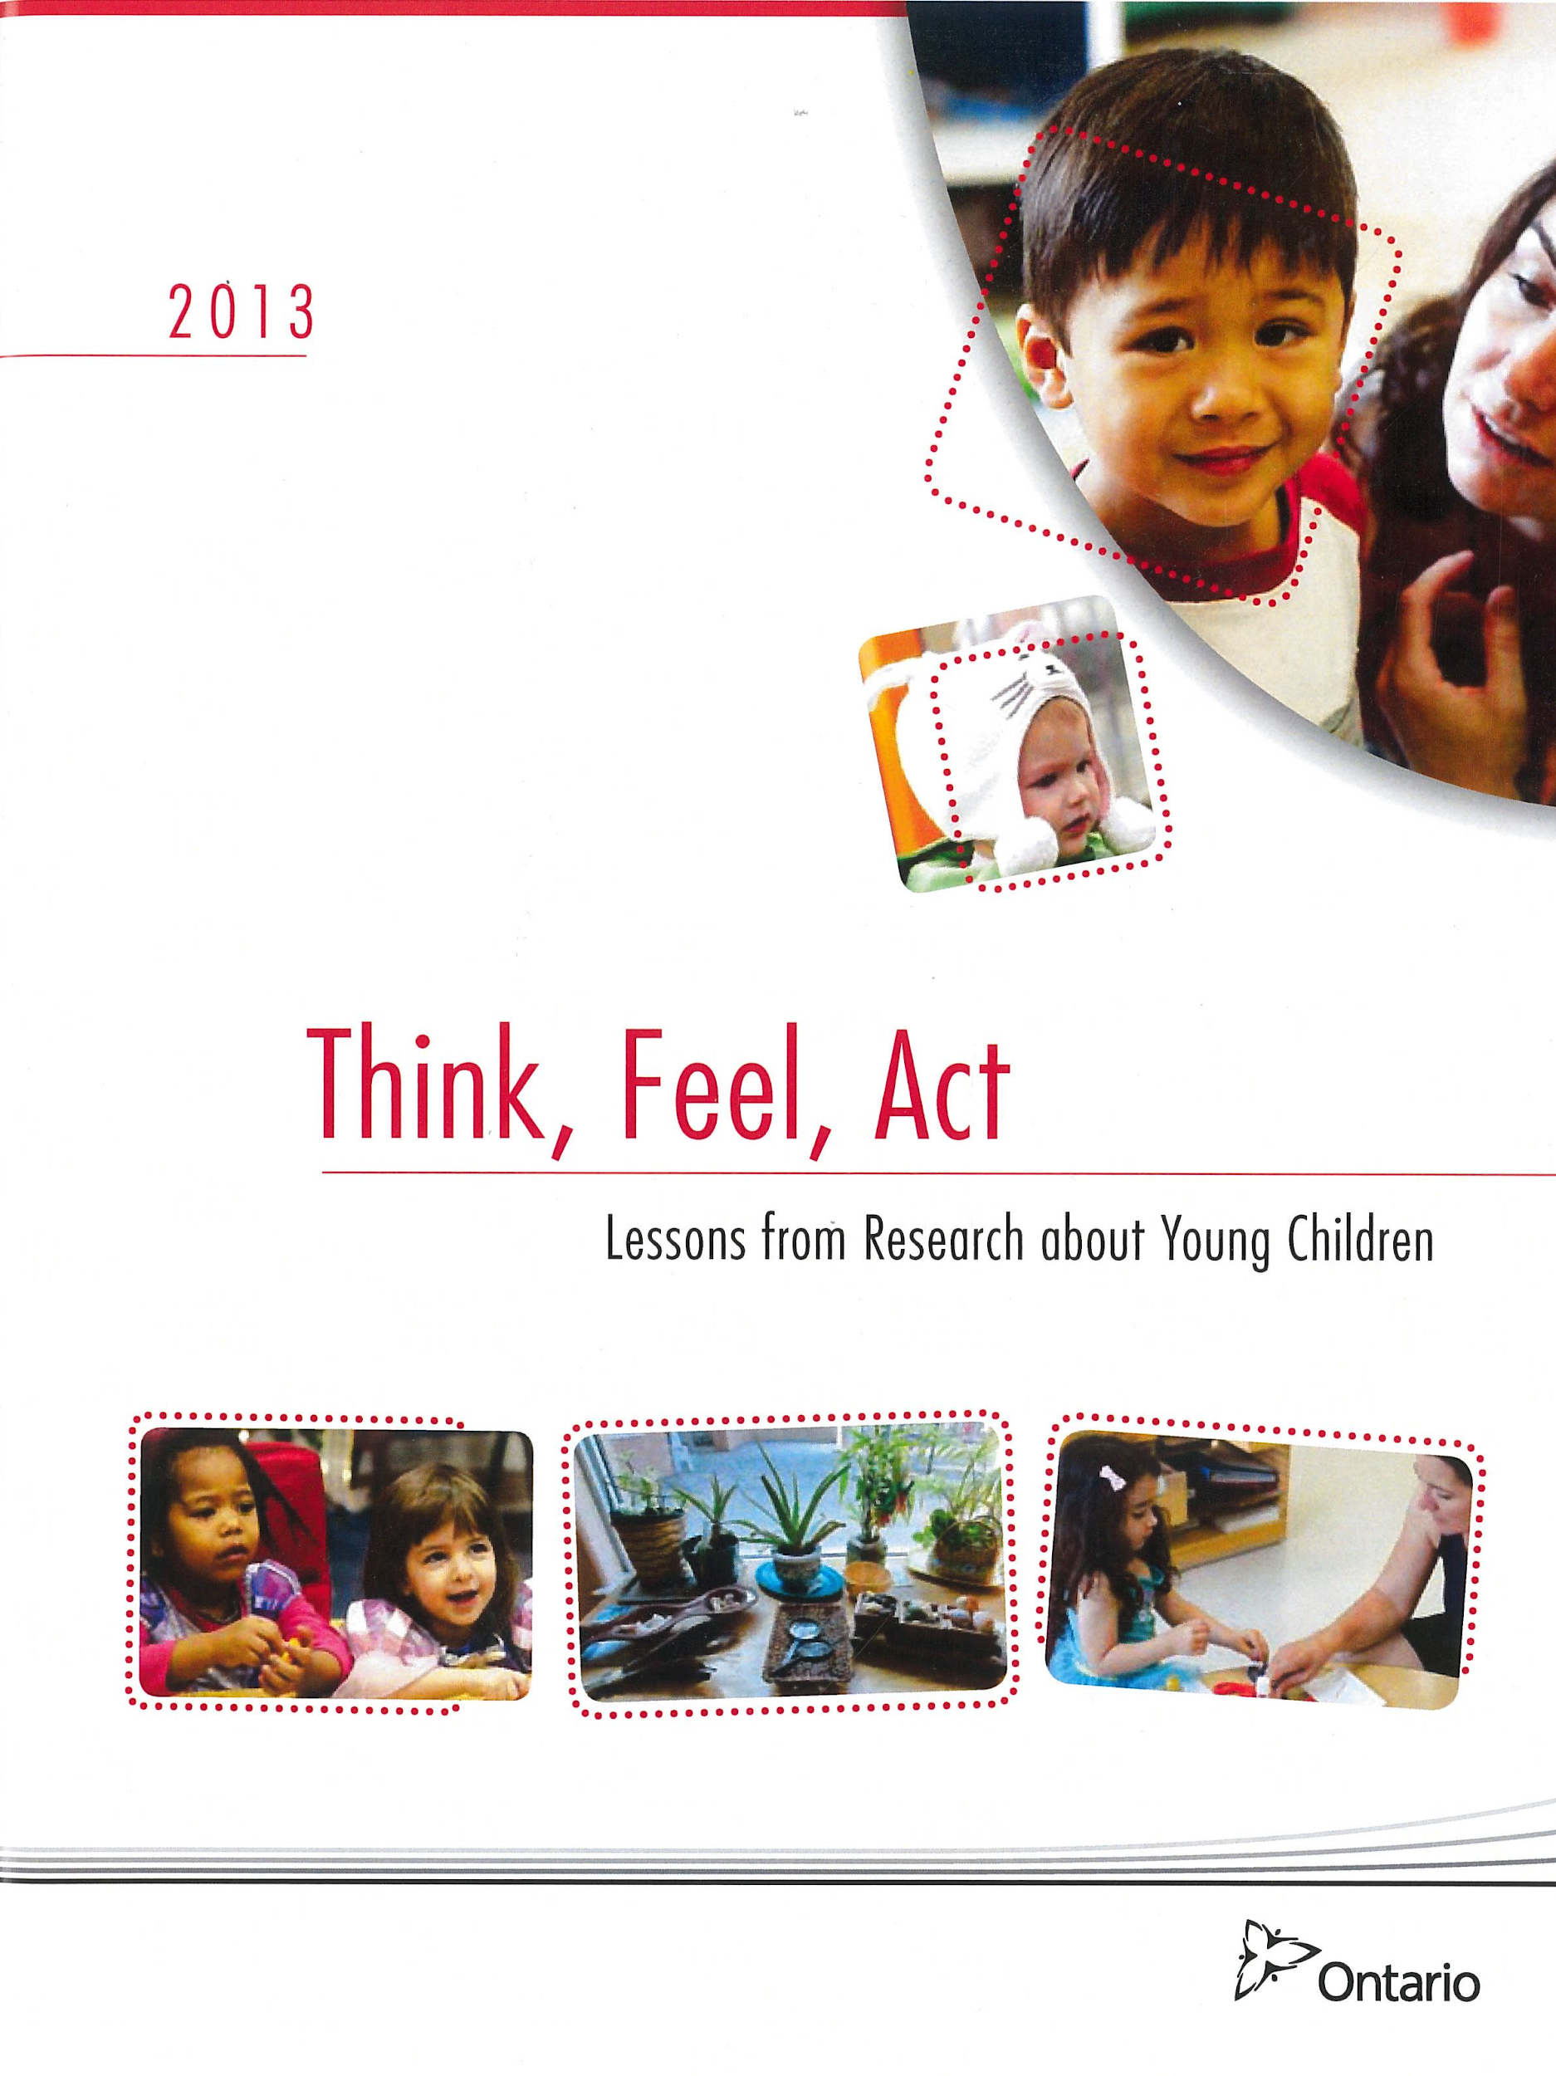
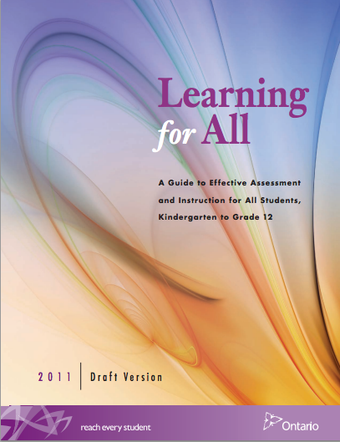
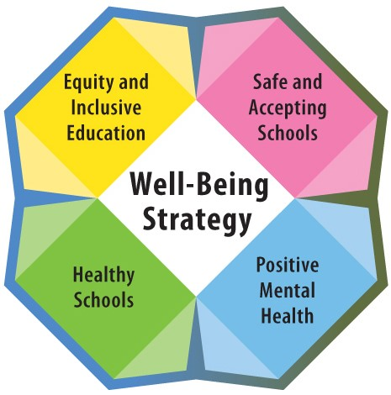
The Power of Positive Adult and Child Relationships: Connection is the Key

Slide 10
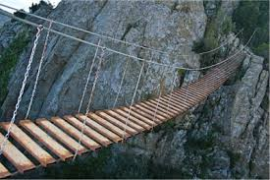
Rose and Al’s Definition
“The mental space or bridge between the amygdala and the prefrontal cortex that gives us the time to pause, reflect and acknowledge our feelings and the many strategies and supports that can respond to those feelings and bring us greater peace, dignity and hope”

Slide 11
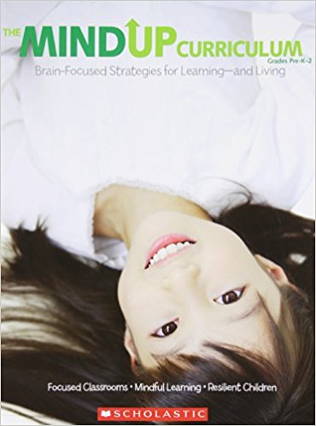
Notes:
How do we intentionally and explicitly teach, model and reinforce mindfulness in our daily routines and practices in the classroom?

Slide 12
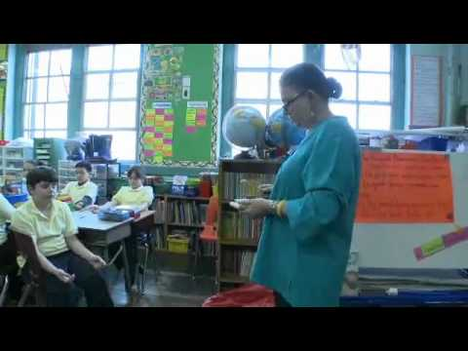
MindUP Curriculum

Slide 13
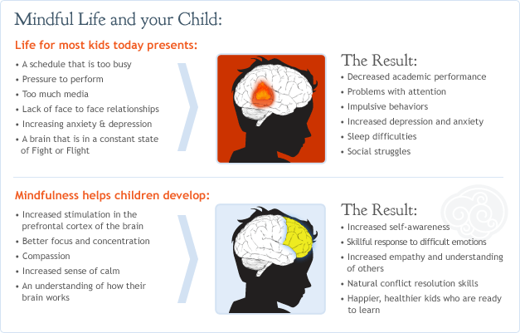

Slide 14
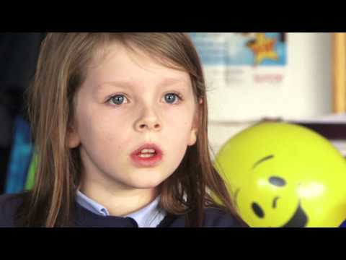
How it makes me feel!

Slide 15
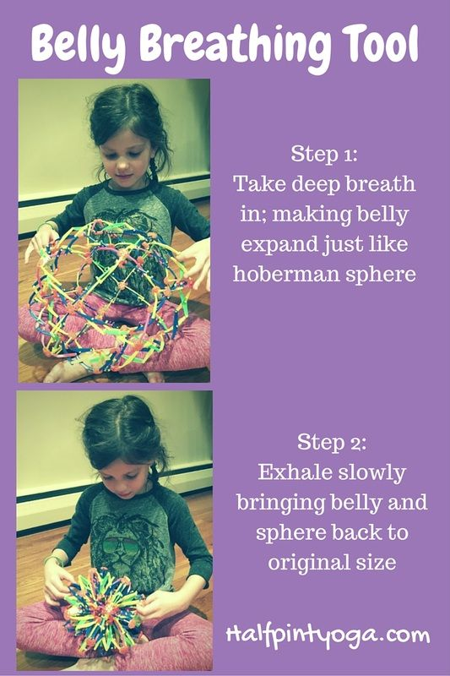
Breathing Ball

Slide 16
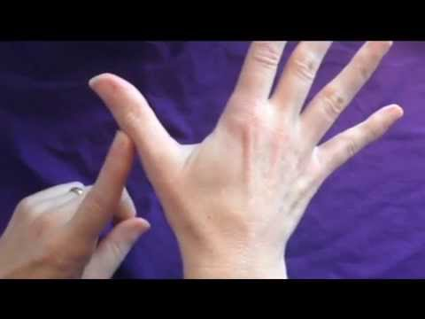
Take 5 Breathing

Slide 17
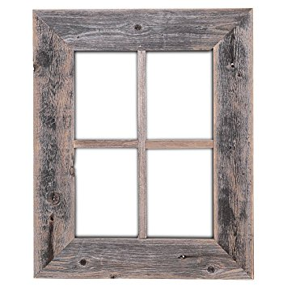
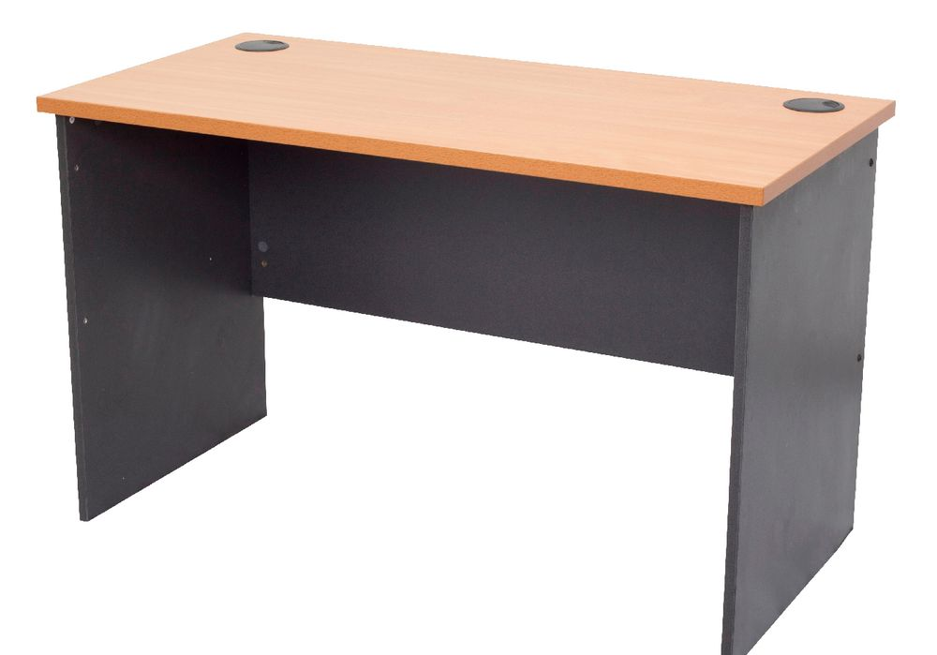
Four Frame Breathing

Slide 18
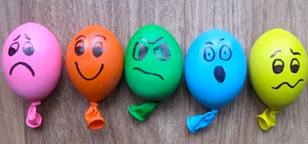
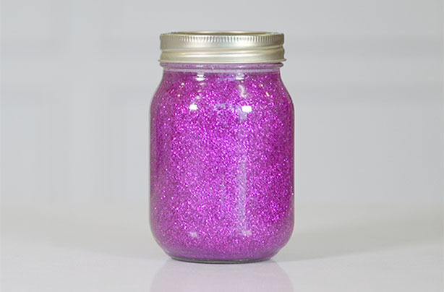
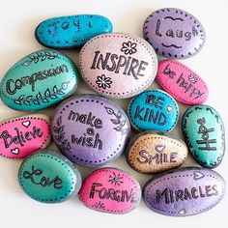
Mindfulness Strategies and Tools
Calming Balls
Affirmation Rocks
Calming Jar

Slide 19
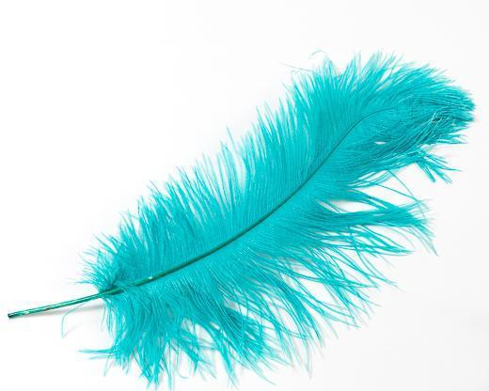
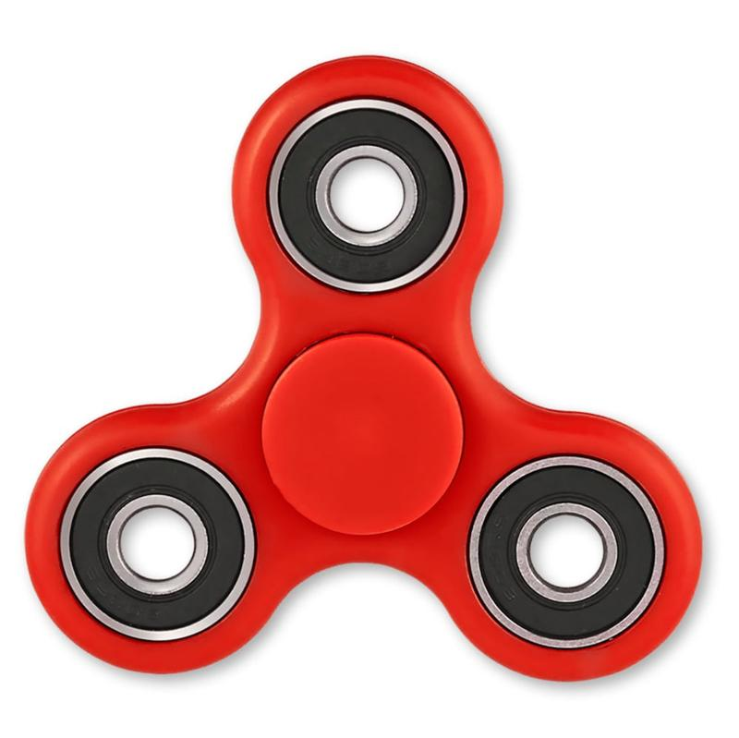
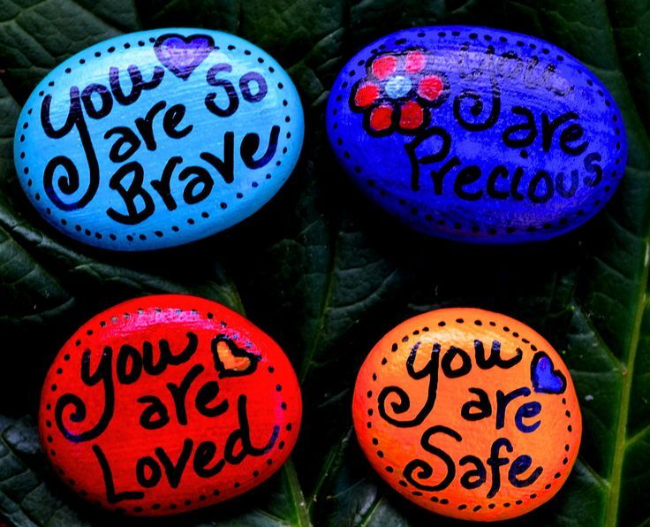
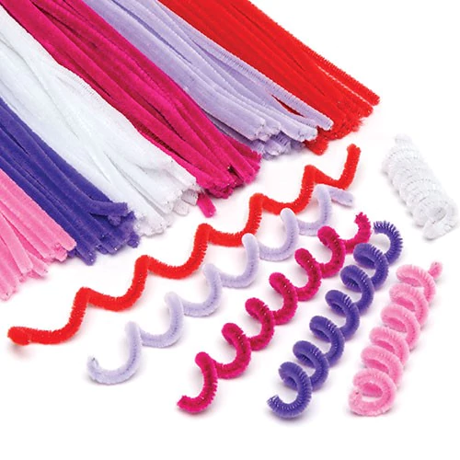
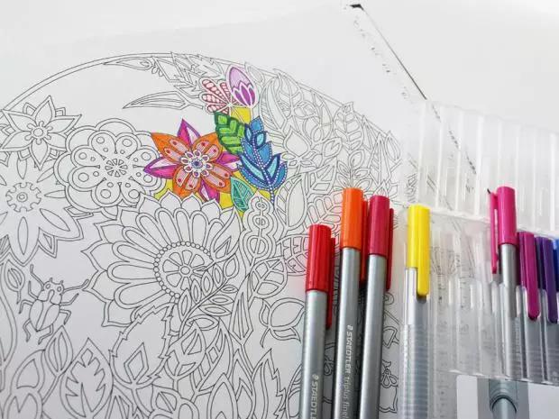
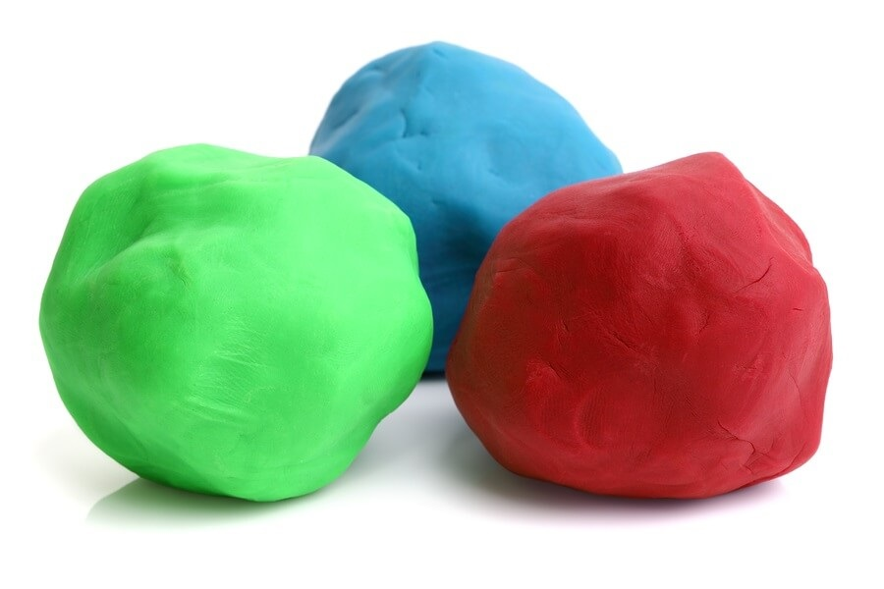
Mindfulness Tools
Tool Kit
Notes:
Engage in some activities
Feather breath solo, partner, on the floor - write an affirmation on a card and tag to a feather
Straw and pom pom - solo, partner, group wave
Rainbow breathing - crayons and cue cards
Affirmation rocks - time allows
Explore the tool box that will go back to each school (playdough, bubbles, pinwheel, mindful colouring books, bubble wrap, straw, pompom, feather, fidget spinner, belly breathing card, take 5 breathing card)

Slide 20
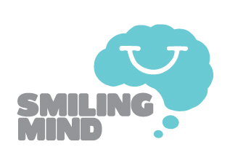
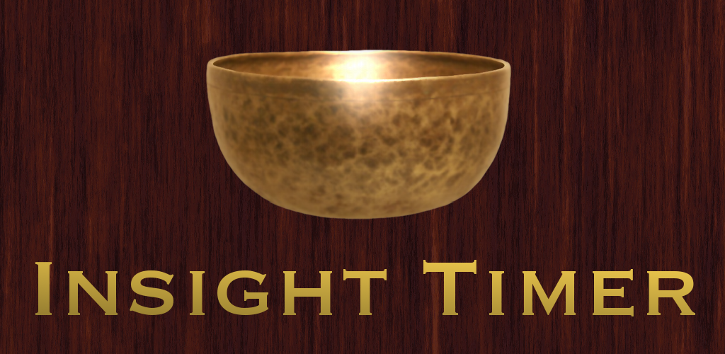
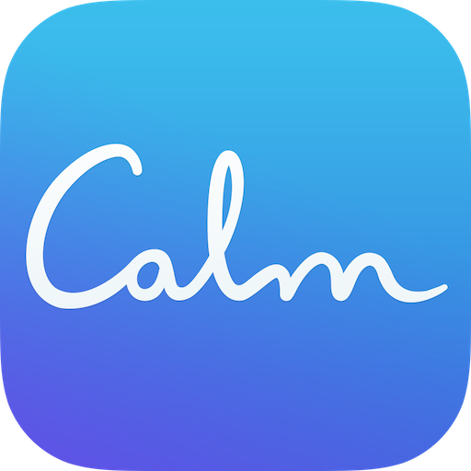

Slide 21
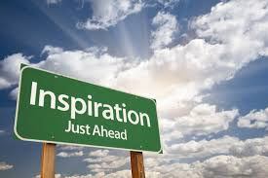
Inspirational videos and resources

Slide 22
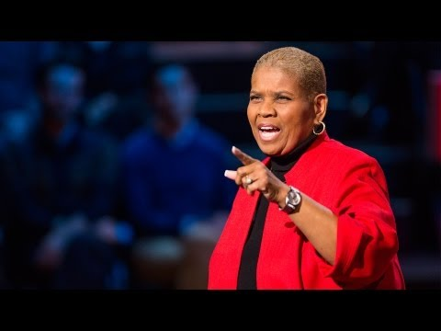
Every child needs a champion

Slide 23
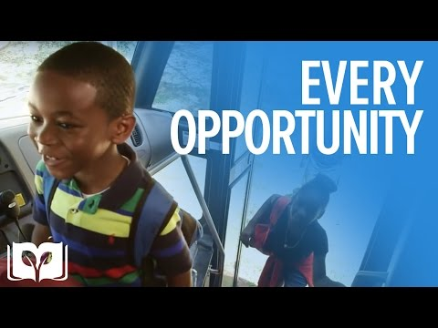
Every OPPortunity...

Slide 24
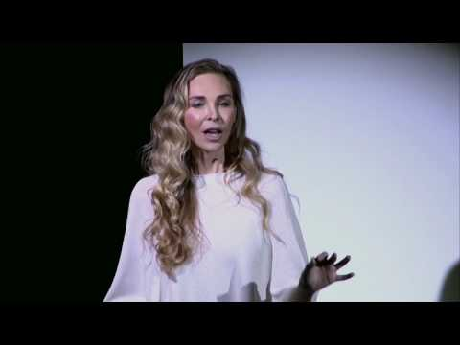
What you practice grows stronger

Slide 25
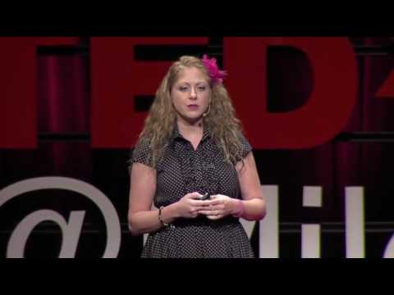
Mindfulness research and videos
https://www.youtube.com/watch?v=eOW7wMmy8Mo
https://www.youtube.com/watch?v=-yJPcdiLEkI

Slide 26
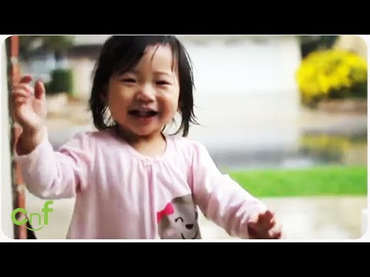
Nothing without JOy… Being Present

Slide 27
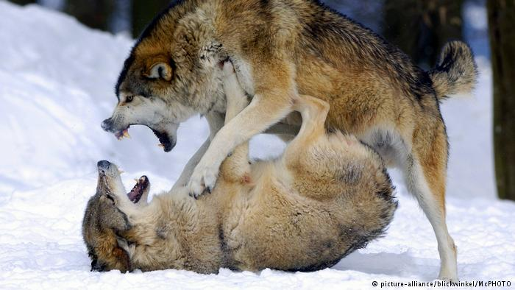
Evil
Anger
Envy
Sorrow
Regret
Greed
Arrogance
Self-pity
Guilt
Resentment
Inferiority
Lies
False pride
Superiority
Ego
Good
Joy
Peace
Love
Hope
Serenity
Humility
Kindness
Empathy
Generosity
Truth
Compassion
Benevolence
Harmony
Faith
Notes:
An old Cherokee elder is teaching his grandson about life. “A fight is going on inside of us, he said to the boy. It is a terrible fight and it is between 2 wolves. One is evil, he is filled with anger, envy, sorrow, regret, greed, arrogance, self-pity, guilt, resentment, inferiority, lies, false pride, superiority, and ego. He continued, the other is good, he is filled with joy, peace, love, hope, serenity, humility, kindness, empathy, generosity, truth, compassion, benevolence,, and faith. This fight will go on inside of you and inside every other person, too.” The grandson thought for a minute and then asked his grandfather, “which wolf will win” The old cherokee eder replied, “the one you feed. “

Slide 28
A Mindful Brain: Collaborative Inquiry
Google Drive Folder
https://goo.gl/34xAEZ

